Slide 1



Covert Communication with Mismatched decoders
Qiaosheng (Eric) Zhang
Vincent Y. F. Tan
Shanghai AI Laboratory
National University of Singapore

Slide 2
Outline
The Covert Communication Problem
Classical models
Mismatched decoding models
Main Results
Lower bound (Theorem 1)
Upper bound (Theorem 2)
Specialized to binary-input binary-output Channels
Specialized to the zero undetected error problem
Proof Techniques
An Improved Upper Bound

Slide 3

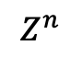
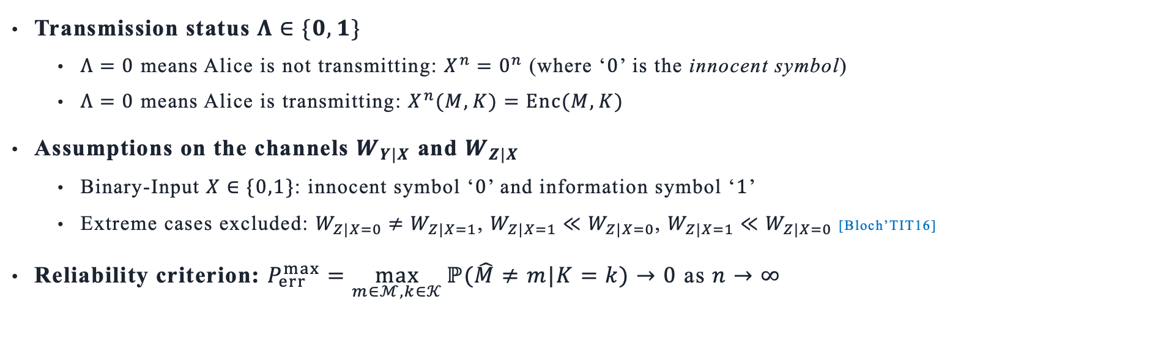
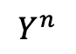
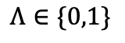
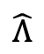
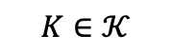
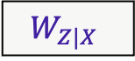

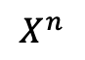
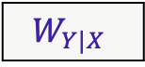

Covert Communication: Classical Model
$$K∈𝒦$$
$$X^{n}$$
$$Y^{n}$$
Bob
$$M∈ℳ$$
Enc
$$W_{Y|X}$$
Dec
$$\hat{M}$$
Alice
$$Λ∈\{0,1\}$$
$$W_{Z|X}$$
$$Z^{n}$$
Willie
Estimator s
$$\hat{Λ}$$
Transmission status $Λ∈\{0,1\}$
$Λ=0$ means Alice is not transmitting: $X^{n}=0^{n}$ (where ‘$0$’ is the innocent symbol)
$Λ=0$ means Alice is transmitting: $X^{n}(M,K)=Enc(M,K)$
Assumptions on the channels $W_{Y|X}$ and $W_{Z|X}$
Binary-Input $X∈\{0,1\}$: innocent symbol ‘$0$’ and information symbol ‘$1$’
Extreme cases excluded: $W_{Z|X=0}≠W_{Z|X=1}$, $W_{Z|X=1}≪W_{Z|X=0}$, $W_{Z|X=1}≪W_{Z|X=0}$ [Bloch’TIT16]
Reliability criterion: $P_{err}^{max}=\max_{m∈ℳ,k∈𝒦}{ℙ(\hat{M}≠m|K=k)}→0$ as $n→∞$
[Bloch’TIT16] Covert communication over noisy channels: A resolvability perspective, IEEE Trans. Inf. Theory, 2016
Notes:
Why binary-input: (1) for simplicity; (2) the optimality of PPM has only been established for binary-input DMC (while it is plausible that it also extends to general DMCs, it needs some additional proofs).

Slide 4
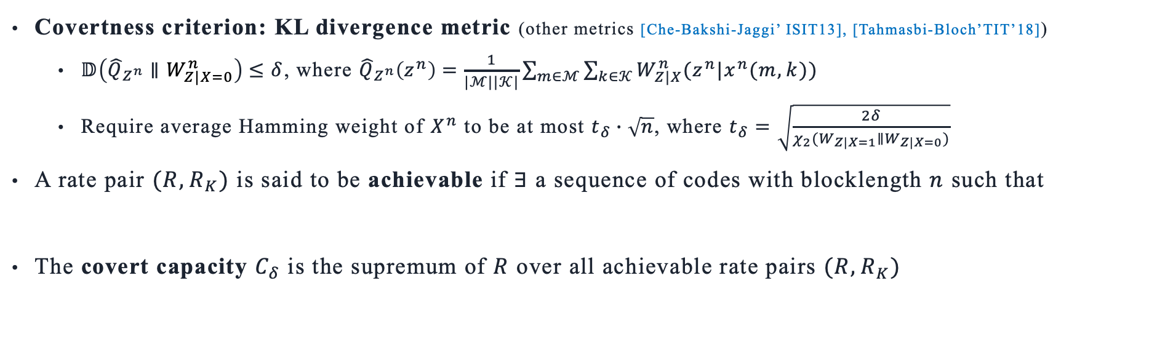
Covert Communication: Classical Model
$$K∈𝒦$$
$$X^{n}$$
$$Y^{n}$$
Bob
$$M∈ℳ$$
Enc
$$W_{Y|X}$$
Dec
$$\hat{M}$$
Alice
$$Λ∈\{0,1\}$$
$$W_{Z|X}$$
$$Z^{n}$$
Willie
Estimator s
$$\hat{Λ}$$
Covertness criterion: KL divergence metric (other metrics [Che-Bakshi-Jaggi’ ISIT13], [Tahmasbi-Bloch’TIT’18])
$𝔻\left({\hat{Q}}_{Z^{n}}∥W_{Z|X=0}^{n}\right)≤δ$, where ${\hat{Q}}_{Z^{n}}\left(z^{n}\right)=\frac{1}{|ℳ||𝒦|}\sum_{m∈ℳ}{\sum_{k∈𝒦}{W_{Z|X}^{n}(z^{n}|x^{n}(m,k))}}$
Require average Hamming weight of $X^{n}$ to be at most $t_{δ}∙\sqrt{n}$, where $t_{δ}=\sqrt{\frac{2δ}{χ_{2}(W_{Z|X=1}∥W_{Z|X=0})}}$
A rate pair $(R,R_{K})$ is said to be achievable if $∃$ a sequence of codes with blocklength $n$ such that
The covert capacity $C_{δ}$ is the supremum of $R$ over all achievable rate pairs $(R,R_{K})$
$\lim_{n→∞}\frac{\log{|ℳ|}}{\sqrt{n}}≥R$, $\lim_{n→∞}\frac{\log{|𝒦|}}{\sqrt{n}}≤R_{K}$, $\lim_{n→∞}{𝔻\left({\hat{Q}}_{Z^{n}}∥W_{Z|X=0}^{n}\right)≤δ}$, $\lim_{n→∞}{P_{err}^{max}=0}$
[Che-Bakshi-Jaggi’ISIT13] Reliable deniable communication: Hiding messages in noise, IEEE ISIT, 2013
[Tahmasbi-Bloch’TIT18] First- and second-order asymptotics in covert communication, IEEE Trans. Inf. Theory, 2018

Slide 5
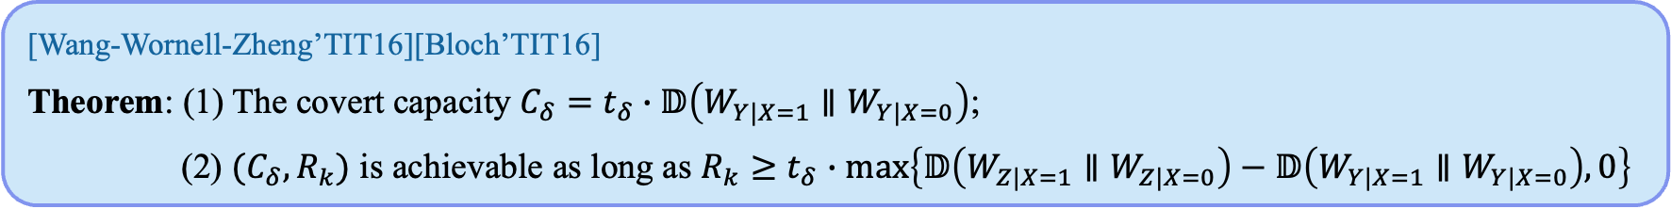
Covert Communication: Classical Model
$$K∈𝒦$$
$$X^{n}$$
$$Y^{n}$$
Bob
$$M∈ℳ$$
Enc
$$W_{Y|X}$$
Dec
$$\hat{M}$$
Alice
$$Λ∈\{0,1\}$$
$$W_{Z|X}$$
$$Z^{n}$$
Willie
Estimator s
$$\hat{Λ}$$
Covertness criterion: KL divergence metric (other metrics [Che-Bakshi-Jaggi’ ISIT13], [Tahmasbi-Bloch’TIT’18])
$𝔻\left({\hat{Q}}_{Z^{n}}∥W_{Z|X=0}^{n}\right)≤δ$, where ${\hat{Q}}_{Z^{n}}\left(z^{n}\right)=\frac{1}{|ℳ||𝒦|}\sum_{m∈ℳ}{\sum_{k∈𝒦}{W_{Z|X}^{n}(z^{n}|x^{n}(m,k))}}$
Require average Hamming weight of $X^{n}$ to be at most $t_{δ}∙\sqrt{n}$, where $t_{δ}=\sqrt{\frac{2δ}{χ_{2}(W_{Z|X=1}∥W_{Z|X=0})}}$
A rate pair $(R,R_{K})$ is said to be achievable if $∃$ a sequence of codes with blocklength $n$ such that
The covert capacity $C_{δ}$ is the supremum of $R$ over all achievable rate pairs $(R,R_{K})$
[Wang-Wornell-Zheng’TIT16][Bloch’TIT16]
Theorem: (1) The covert capacity $C_{δ}=t_{δ}∙𝔻\left(W_{Y|X=1}∥W_{Y|X=0}\right)$;
(2) $(C_{δ},R_{k})$ is achievable as long as $R_{k}≥$ $t_{δ}$ $∙max\left\{𝔻\left(W_{Z|X=1}∥W_{Z|X=0}\right)−𝔻\left(W_{Y|X=1}∥W_{Y|X=0}\right), 0\right\}$
$\lim_{n→∞}\log{|ℳ|}/\sqrt{n}≥R$, $\lim_{n→∞}\log{|𝒦|}/\sqrt{n}≤R_{K}$, $\lim_{n→∞}{𝔻({\hat{Q}}_{Z^{n}}||W_{Z|X=0}^{n})≤δ}$, $\lim_{n→∞}{P_{err}^{max}=0}$
[Wang-Wornell-Zheng’TIT16] Fundamental limits of communication with low probability of detection, IEEE Trans. Inf. Theory, 2016
[Bloch’TIT16] Covert communication over noisy channels: A resolvability perspective, IEEE Trans. Inf. Theory, 2016
Notes:
The value of Rk is to ensure the size of whole codebook to be larger than the normalized mutual information of W_{Z|X} (from a channel resolvability perspective)

Slide 6
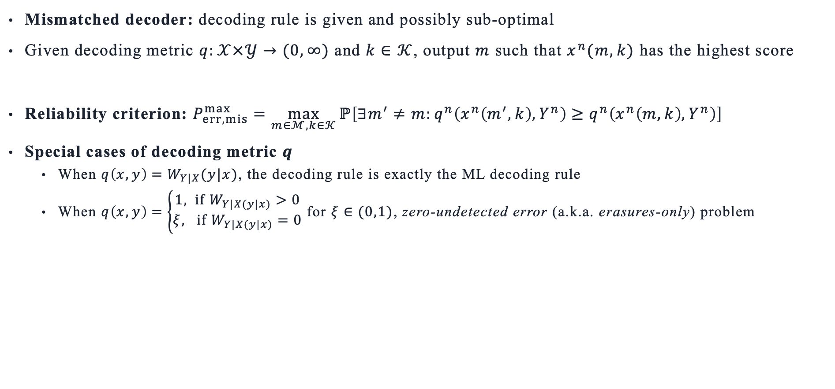
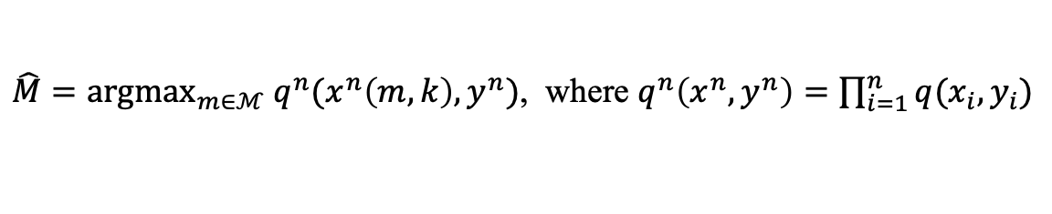
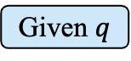
Covert Communication: mismatched decoding
$$K∈𝒦$$
$$X^{n}$$
$$Y^{n}$$
Bob
$$M∈ℳ$$
Enc
$$W_{Y|X}$$
Given $q$
$$\hat{M}$$
Alice
$$Λ∈\{0,1\}$$
$$W_{Z|X}$$
$$Z^{n}$$
Willie
Estimator s
$$\hat{Λ}$$
Mismatched decoder: decoding rule is given and possibly sub-optimal
Given decoding metric $q:𝒳×𝒴→(0,∞)$ and $k∈$ $𝒦$, output $m$ such that $x^{n}(m,k)$ has the highest score
Reliability criterion: $P_{err,mis}^{max}=\max_{m∈ℳ,k∈𝒦}{ℙ\left[∃m^{′}≠m:q^{n}\left(x^{n}\left(m^{′},k\right),Y^{n}\right)≥q^{n}\left(x^{n}\left(m,k\right),Y^{n}\right)\right]}$
Special cases of decoding metric $q$
When $q\left(x,y\right)=W_{Y|X}(y|x)$, the decoding rule is exactly the ML decoding rule
When $q\left(x,y\right)=\left\{\begin{aligned}1, if W_{Y|X(y|x)}>0 \\ ξ, if W_{Y|X(y|x)}=0\end{aligned}\right.$ for $ξ∈(0,1)$, zero-undetected error (a.k.a. erasures-only) problem
$\hat{M}=argmax_{m∈ℳ} q^{n}(x^{n}\left(m,k\right),y^{n})$, where $q^{n}\left(x^{n},y^{n}\right)=\prod_{i=1}^{n}{q(x_{i},y_{i})}$
Notes:
We consider q: X*Y \to (0, infty) for simplicity. In general, one should also consider the case when q is allowed to be 0, but it turns out to be very complicated for our covert communication setting.
We will describe what is zero-undetected error problem later.

Slide 7
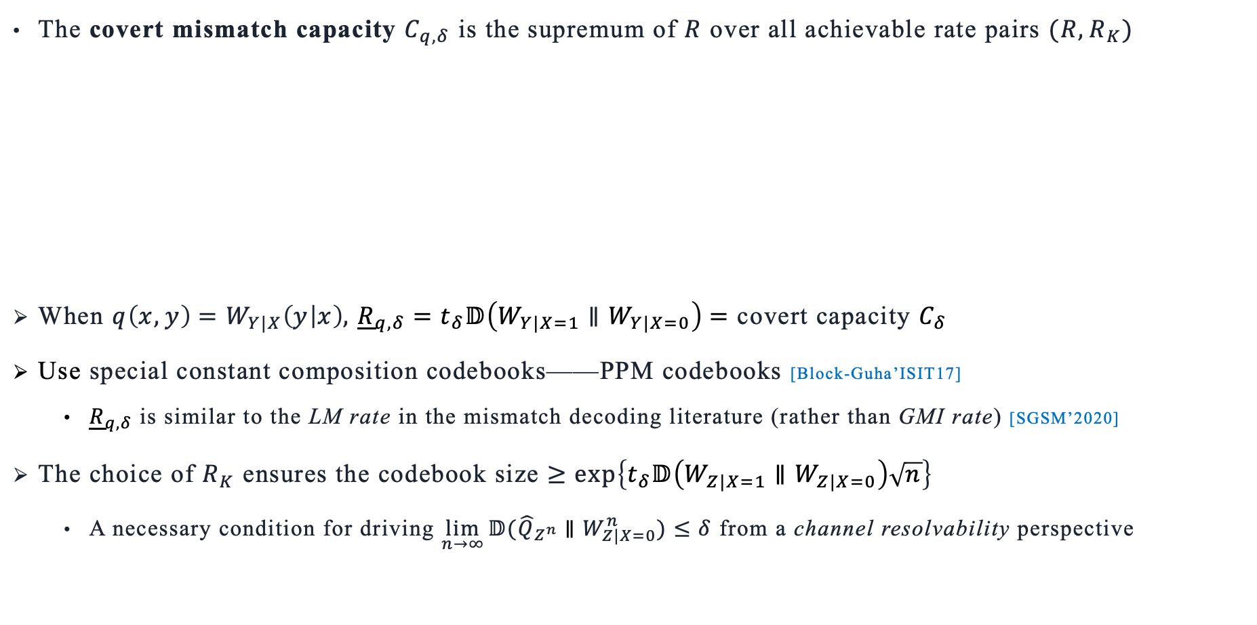
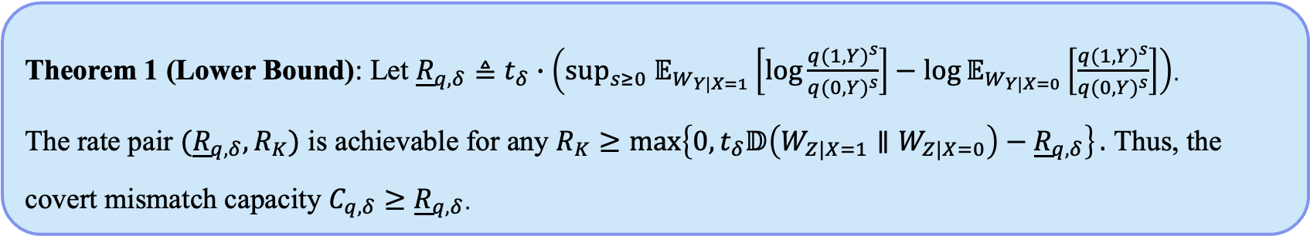
Main results
The covert mismatch capacity $C_{q,δ}$ is the supremum of $R$ over all achievable rate pairs $(R,R_{K})$
When $q\left(x,y\right)=W_{Y|X}\left(y | x\right),$ ${\underline{R}}_{q,δ}=t_{δ}𝔻\left(W_{Y|X=1}∥W_{Y|X=0}\right)=$ covert capacity $C_{δ}$
Use special constant composition codebooks——PPM codebooks [Block-Guha’ISIT17]
${\underline{R}}_{q,δ}$ is similar to the LM rate in the mismatch decoding literature (rather than GMI rate) [SGSM’2020]
The choice of $R_{K}$ ensures the codebook size $≥\exp\left\{t_{δ}𝔻\left(W_{Z|X=1}∥W_{Z|X=0}\right)\sqrt{n}\right\}$
A necessary condition for driving $\lim_{n→∞}{𝔻({\hat{Q}}_{Z^{n}}∥W_{Z|X=0}^{n})≤δ}$ from a channel resolvability perspective
Theorem 1 (Lower Bound): Let ${\underline{R}}_{q,δ}≜t_{δ}∙\left(\sup_{s≥0} 𝔼_{W_{Y|X=1}}\left[\log{\frac{q(1,Y)^{s}}{q(0,Y)^{s}}}\right]−\log{𝔼_{W_{Y|X=0}}\left[\frac{q(1,Y)^{s}}{q(0,Y)^{s}}\right]}\right)$.
The rate pair $({\underline{R}}_{q,δ},R_{K})$ is achievable for any $R_{K}≥\max\left\{0,t_{δ}𝔻\left(W_{Z|X=1}∥W_{Z|X=0}\right)−{\underline{R}}_{q,δ}\right\}.$ Thus, the covert mismatch capacity $C_{q,δ}$ $≥$ ${\underline{R}}_{q,δ}$.
LB is optimal under matched case
[Bloch-Guha’ ISIT17] Optimal covert communications using pulse-position modulation, IEEE ISIT, 2017
[SGSM’ 2020] Scarlett, Guillén i Fàbregas, Somekh-Baruch, Martinez, Information-theoretic foundation of mismatched decoding, Found. Trends Comm. Inf. Theory, 2020
Notes:
In classical mismatch decoding literature, LM rate is achieved via constant composition code, GMI rate is achieved via IID code.

Slide 8
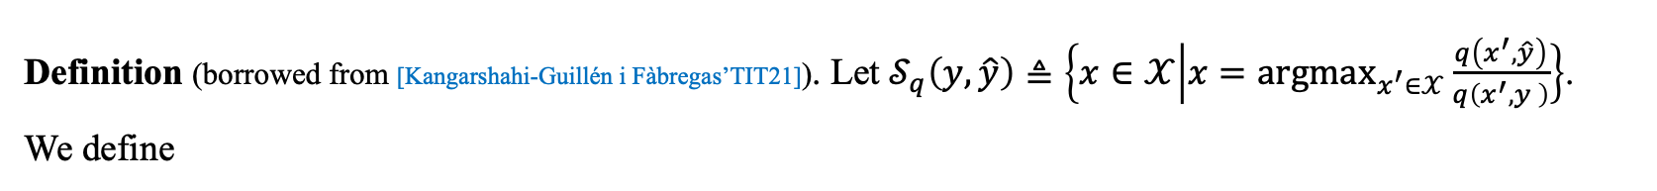
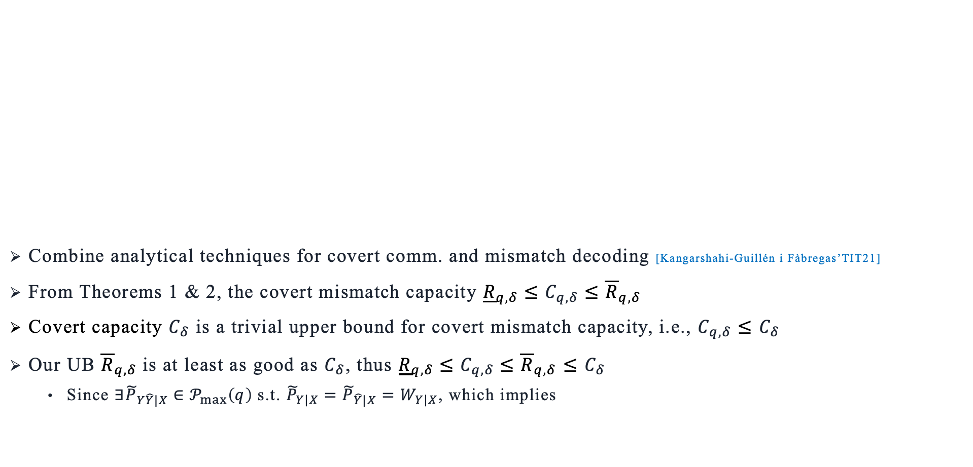
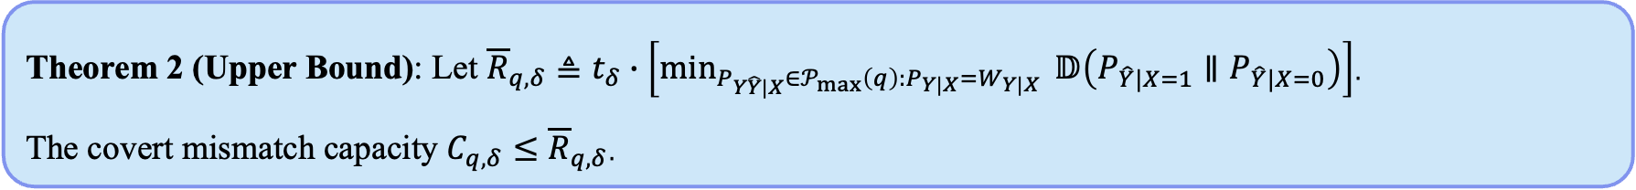
Main results
Combine analytical techniques for covert comm. and mismatch decoding [Kangarshahi-Guillén i Fàbregas’TIT21]
From Theorems 1 & 2, the covert mismatch capacity ${\underline{R}}_{q,δ}≤C_{q,δ}≤{\overline{R}}_{q,δ}$
Covert capacity $C_{δ}$ is a trivial upper bound for covert mismatch capacity, i.e., $C_{q,δ}≤$ $C_{δ}$
Our UB ${\overline{R}}_{q,δ}$is at least as good as $C_{δ}$, thus ${\underline{R}}_{q,δ}≤C_{q,δ}≤{\overline{R}}_{q,δ}$ $≤$ $C_{δ}$
Since $∃{\tilde{P}}_{Y\hat{Y}|X}∈𝒫_{max}\left(q\right)$ s.t. ${\tilde{P}}_{Y|X}={\tilde{P}}_{\hat{Y}|X}=W_{Y|X}$, which implies
Definition (borrowed from [Kangarshahi-Guillén i Fàbregas’TIT21]). Let $𝒮_{q}\left(y,\hat{y}\right)≜\left\{x∈𝒳 | x={argmax}_{x^{′}∈𝒳}\frac{q\left(x^{′},\hat{y}\right)}{q\left(x^{′},y \right)}\right\}$.
We define
$$𝒫_{max}\left(q\right)≜\left\{P_{Y\hat{Y}|X}∈𝒫\left(𝒴×𝒴 | 𝒳\right):P_{Y\hat{Y}|X}\left(y,\hat{y} | x\right)=0 for all \left(y,\hat{y}\right)∈𝒴×𝒴 and x∉𝒮_{q}\left(y,\hat{y}\right)\right\}$$
Theorem 2 (Upper Bound): Let ${\overline{R}}_{q,δ}≜t_{δ}∙\left[\min_{P_{Y\hat{Y}|X}∈𝒫_{max}\left(q\right):P_{Y|X}=W_{Y|X}}{ 𝔻\left(P_{\hat{Y}|X=1}∥P_{\hat{Y}|X=0}\right)}\right]$.
The covert mismatch capacity $C_{q,δ}$ $≤{\overline{R}}_{q,δ}$.
$${\overline{R}}_{q,δ}≤ t_{δ}𝔻\left({\tilde{P}}_{\hat{Y}|X=1}∥{\tilde{P}}_{\hat{Y}|X=0}\right)=t_{δ}𝔻\left(W_{Y|X=1}∥W_{Y|X=0}\right)=C_{δ}$$
[Kangarshahi-Guillén i Fàbregas’TIT21] A single-letter upper bound to the mismatch capacity, IEEE Trans. Inf. Theory, 2021

Slide 9
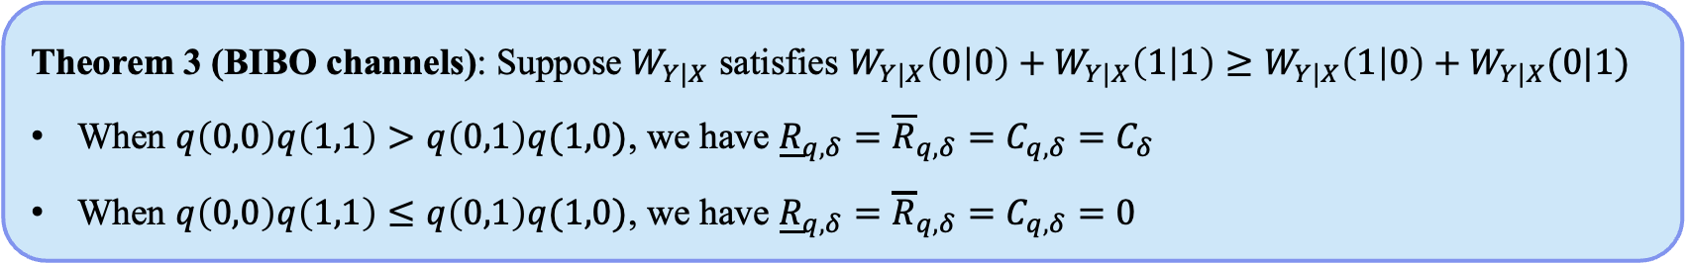
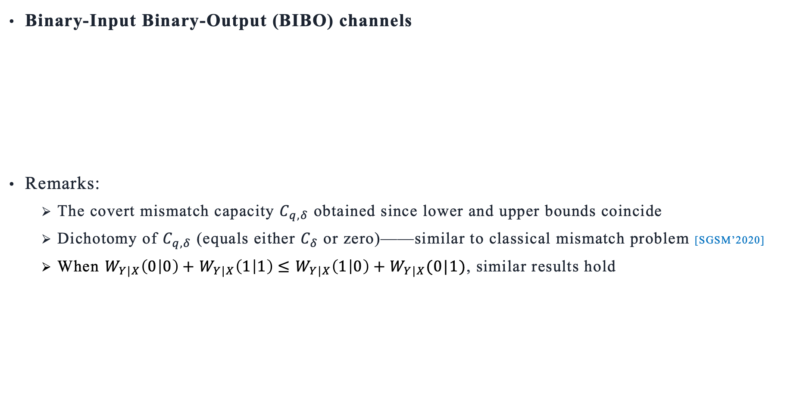
Main results
Binary-Input Binary-Output (BIBO) channels
Remarks:
The covert mismatch capacity $C_{q,δ}$ obtained since lower and upper bounds coincide
Dichotomy of $C_{q,δ}$ (equals either $C_{δ}$ or zero)——similar to classical mismatch problem [SGSM’2020]
When $W_{Y|X}\left(0 | 0\right)+W_{Y|X}\left(1 | 1\right)≤W_{Y|X}\left(1 | 0\right)+W_{Y|X}(0|1)$, similar results hold
Theorem 3 (BIBO channels): Suppose $W_{Y|X}$ satisfies $W_{Y|X}\left(0 | 0\right)+W_{Y|X}\left(1 | 1\right)≥W_{Y|X}\left(1 | 0\right)+W_{Y|X}(0|1)$
When $q\left(0,0\right)q\left(1,1\right)>q\left(0,1\right)q(1,0)$, we have ${\underline{R}}_{q,δ}={\overline{R}}_{q,δ}=C_{q,δ}=C_{δ}$
When $q\left(0,0\right)q\left(1,1\right)≤q\left(0,1\right)q(1,0)$, we have ${\underline{R}}_{q,δ}={\overline{R}}_{q,δ}=C_{q,δ}=0$
[SGSM’ 2020] Scarlett, Guillén i Fàbregas, Somekh-Baruch, Martinez, Information-theoretic foundation of mismatched decoding, Found. Trends Comm. Inf. Theory, 2020

Slide 10
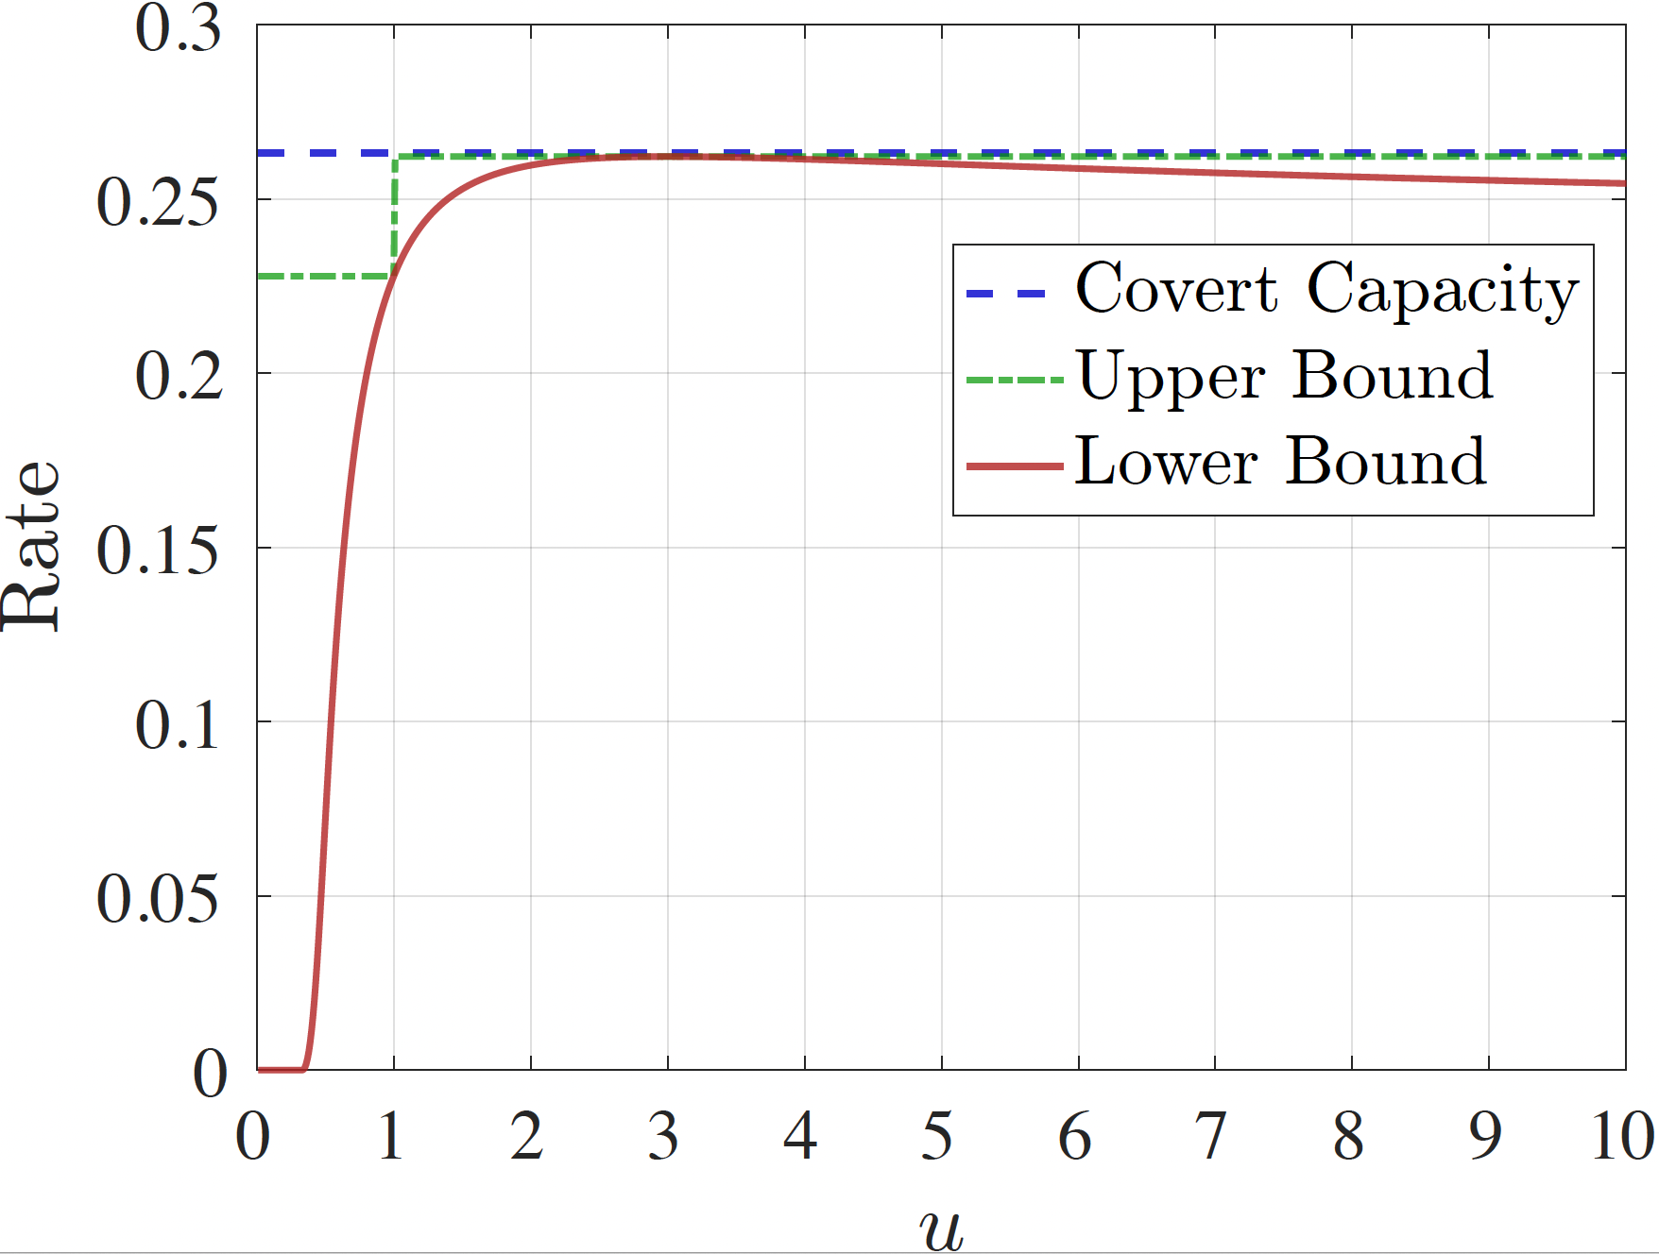
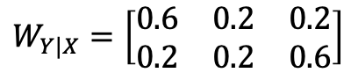
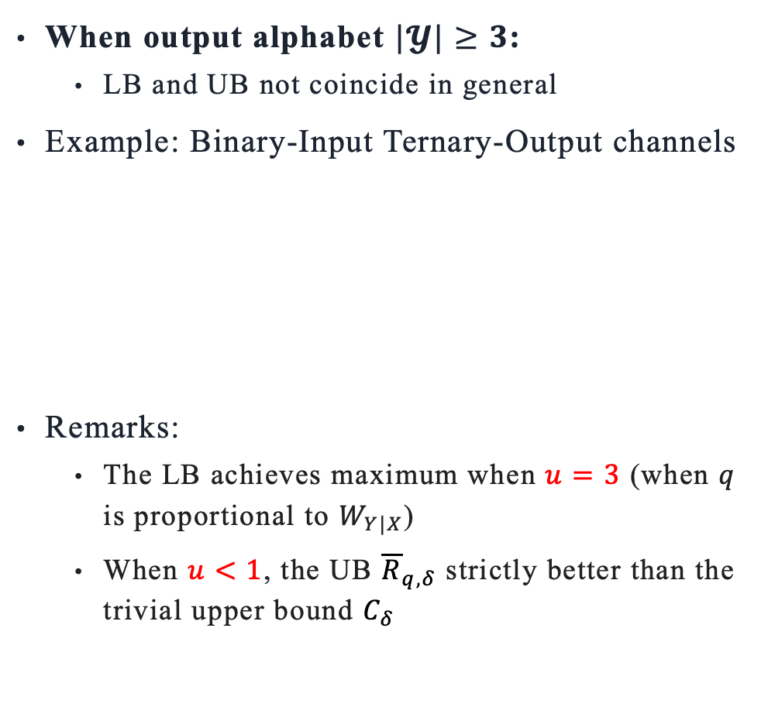
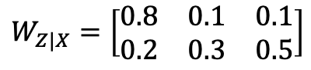
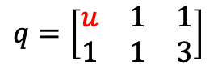
Main results
When output alphabet $|𝓨|≥3$:
LB and UB not coincide in general
Example: Binary-Input Ternary-Output channels
Remarks:
The LB achieves maximum when $u=3$ (when $q$ is proportional to $W_{Y|X}$)
When $u<1$, the UB ${\overline{R}}_{q,δ}$ strictly better than the trivial upper bound $C_{δ}$
$$W_{Y|X}=\left[\begin{matrix}0.6 & 0.2 & 0.2 \\ 0.2 & 0.2 & 0.6\end{matrix}\right]$$
$$q=\left[\begin{matrix}u & 1 & 1 \\ 1 & 1 & 3\end{matrix}\right]$$
$$W_{Z|X}=\left[\begin{matrix}0.8 & 0.1 & 0.1 \\ 0.2 & 0.3 & 0.5\end{matrix}\right]$$

Slide 11
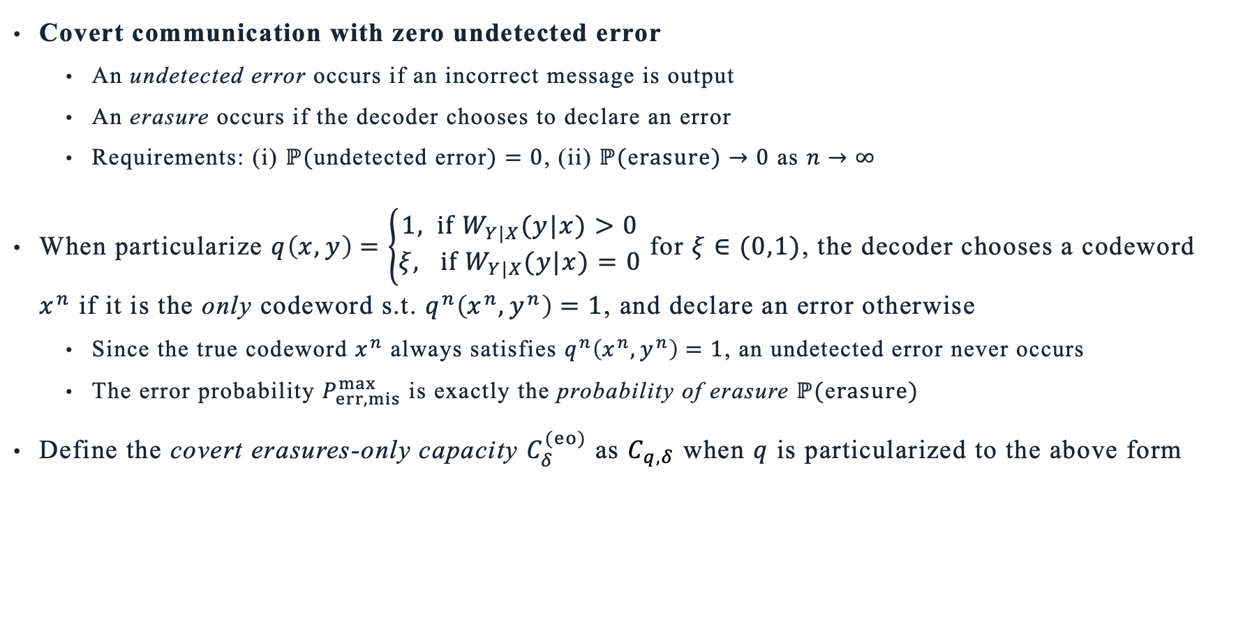
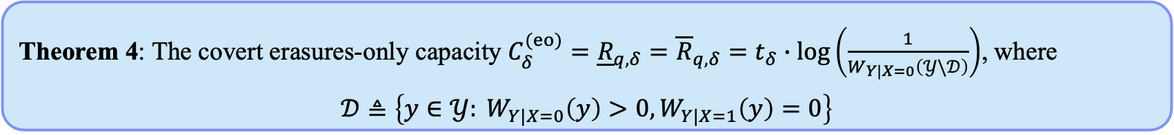
Main results
Covert communication with zero undetected error
An undetected error occurs if an incorrect message is output
An erasure occurs if the decoder chooses to declare an error
Requirements: (i) $ℙ($undetected error$)=0$, (ii) $ℙ($e$rasure)→0$ as $n→∞$
When particularize $q\left(x,y\right)=\left\{\begin{aligned}1, if W_{Y|X}(y|x)>0 \\ ξ, if W_{Y|X}(y|x)=0\end{aligned}\right.$ for $ξ∈(0,1)$, the decoder chooses a codeword $x^{n}$ if it is the only codeword s.t. $q^{n}\left(x^{n},y^{n}\right)=1$, and declare an error otherwise
Since the true codeword $x^{n}$ always satisfies $q^{n}\left(x^{n},y^{n}\right)=1$, an undetected error never occurs
The error probability $P_{err,mis}^{max}$ is exactly the probability of erasure $ℙ($e$rasure)$
Define the covert erasures-only capacity $C_{δ}^{(eo)}$ as $C_{q,δ}$ when $q$ is particularized to the above form
Theorem 4: The covert erasures-only capacity $C_{δ}^{(eo)}=$ ${\underline{R}}_{q,δ}={\overline{R}}_{q,δ}=$ $t_{δ}∙\log\left(\frac{1}{W_{Y|X=0}\left(𝒴\backslash 𝒟\right)}\right)$, where
$$𝒟≜\left\{y∈𝒴: W_{Y|X=0}\left(y\right)>0,W_{Y|X=1}\left(y\right)=0\right\}$$
Notes:
It has not been very clear to me why we can obtain this single-letter capacity expression, while in the classical mismatch decoding problem people cannot. It may be due to the simplicity of our setting---binary-input setting and the frequency of ‘1’is vanishing. I remember I checked that for ternary-input covert communication, we cannot obtain a single-letter expression.

Slide 12
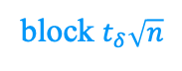
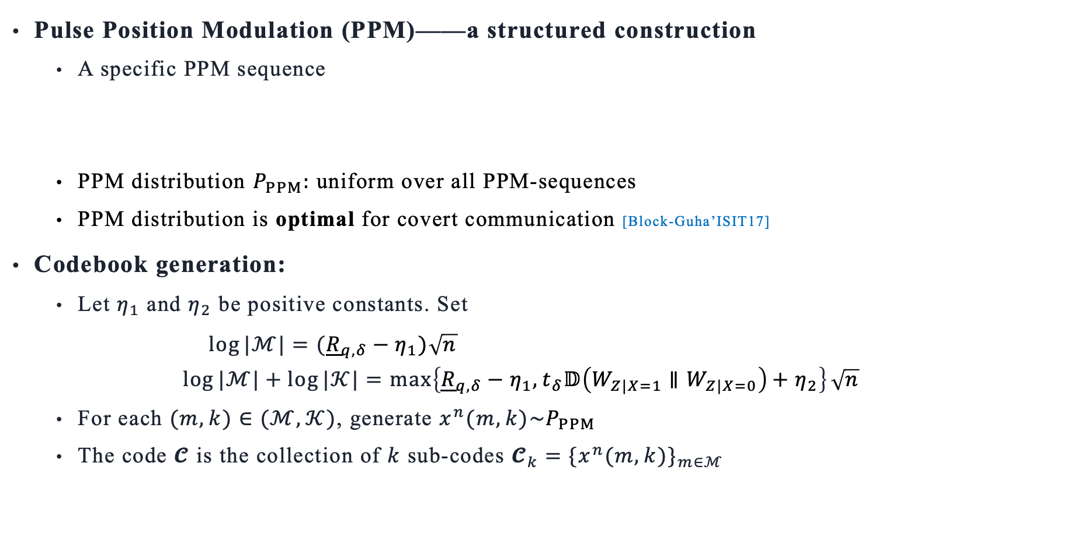
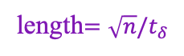
Proof Sketch of Lower Bound (Thm 1)
Pulse Position Modulation (PPM)——a structured construction
A specific PPM sequence
PPM distribution $P_{PPM}:$ uniform over all PPM-sequences
PPM distribution is optimal for covert communication [Block-Guha’ISIT17]
Codebook generation:
Let $η_{1}$ and $η_{2}$ be positive constants. Set
$\log{|ℳ|}=({\underline{R}}_{q,δ}−η_{1})\sqrt{n}$
$$\log{|ℳ|}+\log{|𝒦|}=\max\left\{{\underline{R}}_{q,δ}−η_{1},t_{δ}𝔻\left(W_{Z|X=1}∥W_{Z|X=0}\right)+η_{2}\right\}\sqrt{n}$$
For each $(m,k)∈(ℳ,𝒦)$, generate $x^{n}(m,k)\sim P_{PPM}$
The code $\text{𝓒}$ is the collection of $k$ sub-codes ${\text{𝓒}}_{k}=\{x^{n}(m,k)\}_{m∈ℳ}$
length$=\sqrt{n}/t_{δ}$
block 1
block 2
block $t_{δ}\sqrt{n}$
[Bloch-Guha’ ISIT17] Optimal covert communications using pulse-position modulation, IEEE ISIT, 2017

Slide 13
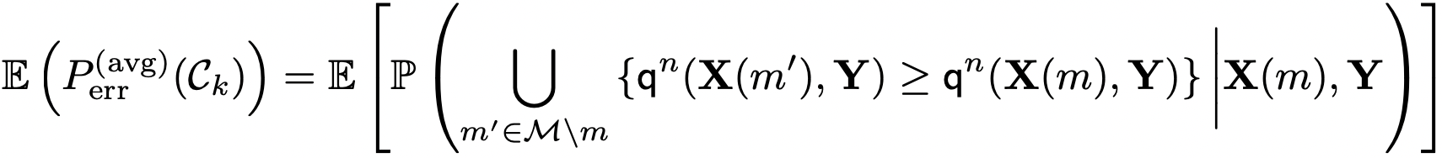
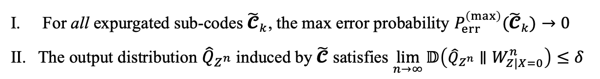
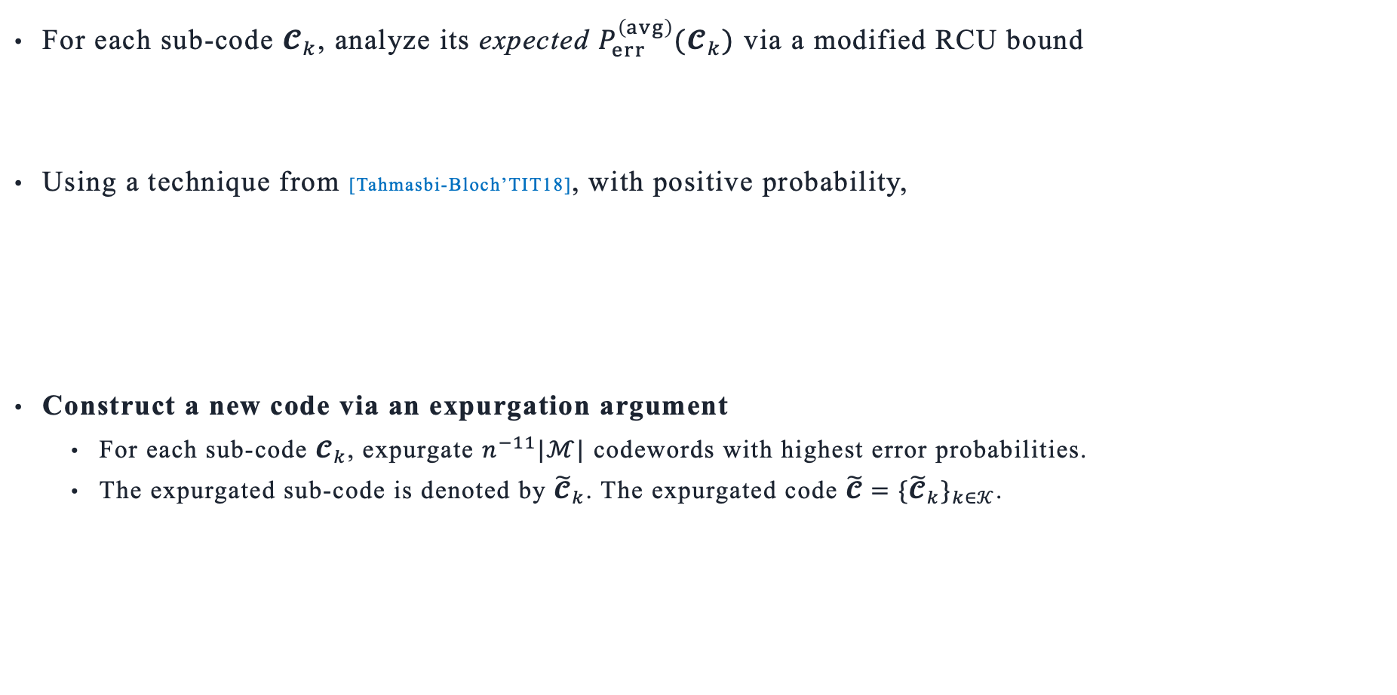
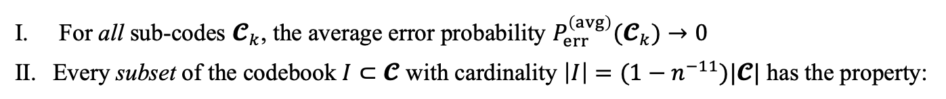
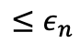
Proof Sketch of Lower Bound (Thm 1)
For each sub-code ${\text{𝓒}}_{k}$, analyze its expected $P_{err}^{\left(avg\right)}({\text{𝓒}}_{k})$ via a modified RCU bound
Using a technique from [Tahmasbi-Bloch’TIT18], with positive probability,
Construct a new code via an expurgation argument
For each sub-code ${\text{𝓒}}_{k}$, expurgate $n^{−11}|ℳ|$ codewords with highest error probabilities.
The expurgated sub-code is denoted by ${\tilde{\text{𝓒}}}_{k}$. The expurgated code $\tilde{\text{𝓒}}=\{{\tilde{\text{𝓒}}}_{k}\}_{k∈𝒦}$.
$$≤ε_{n}$$
For all sub-codes ${\text{𝓒}}_{k}$, the average error probability $P_{err}^{\left(avg\right)}({\text{𝓒}}_{k})→0$
Every subset of the codebook $I⊂\text{𝓒}$ with cardinality $\left|I\right|=(1−n^{−11})|\text{𝓒}|$ has the property:
the induced output distribution ${\hat{Q}}_{Z^{n}}^{I}$satisfies $\lim_{n→∞}{𝔻\left({\hat{Q}}_{Z^{n}}^{I}∥W_{Z|X=0}^{n}\right)≤δ}$
For all expurgated sub-codes ${\tilde{\text{𝓒}}}_{k}$, the max error probability $P_{err}^{\left(max\right)}({\tilde{\text{𝓒}}}_{k})→0$
The output distribution ${\hat{Q}}_{Z^{n}}$ induced by $\tilde{\text{𝓒}}$ satisfies $\lim_{n→∞}{𝔻\left({\hat{Q}}_{Z^{n}}∥W_{Z|X=0}^{n}\right)≤δ}$
[Tahmasbi-Bloch’TIT18] First- and second-order asymptotics in covert communication, IEEE Trans. Inf. Theory, 2018
Notes:
Why we focus on maximum error probability: mainly because the converse result is for the maximum error probability, so we take additional efforts in the achievability part to achieve the maximum error probability.

Slide 14
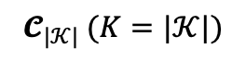
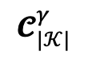
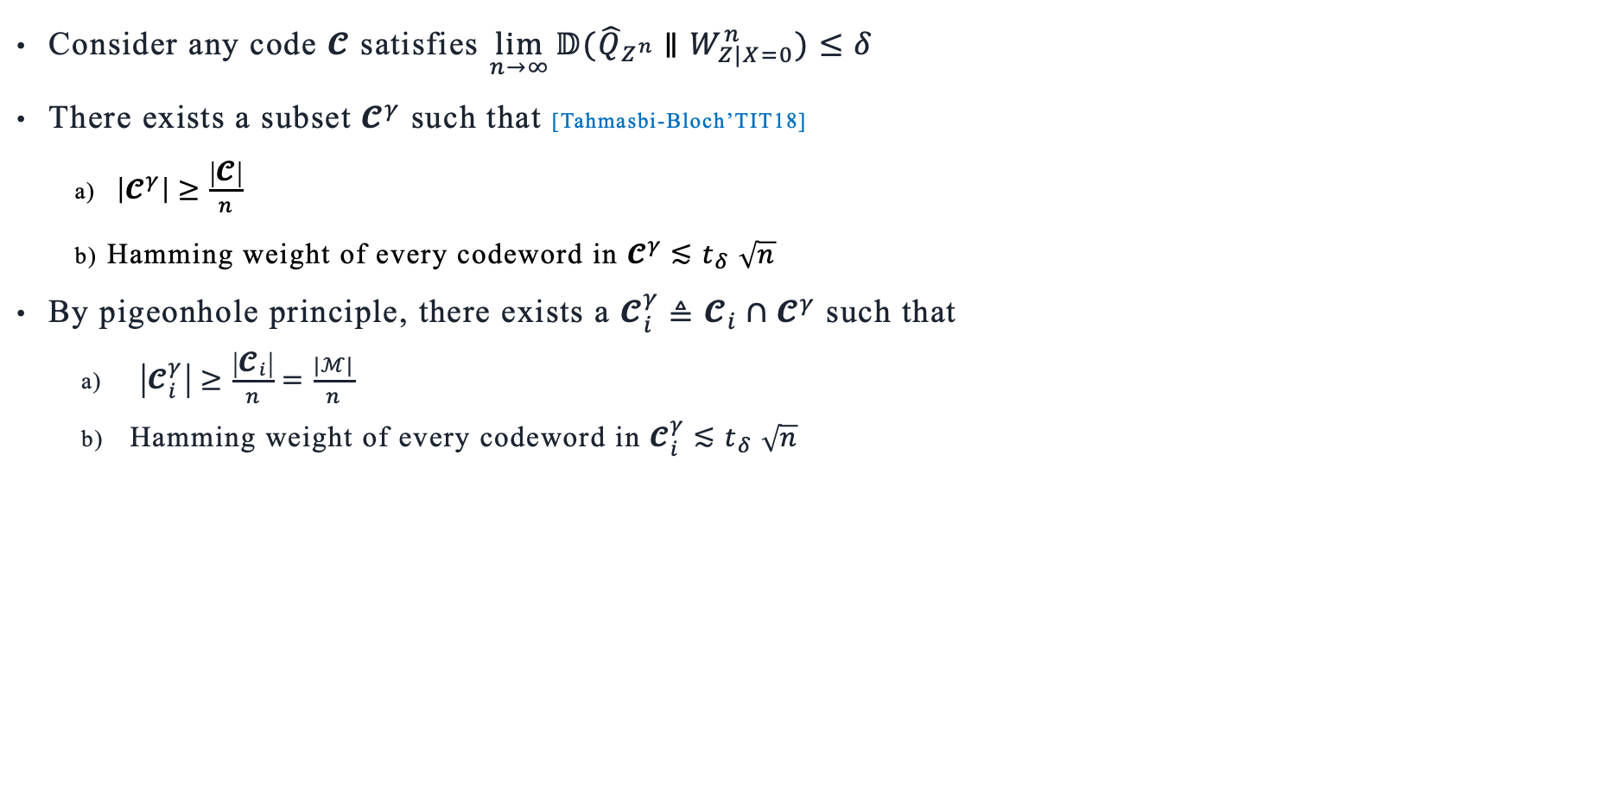
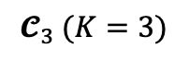
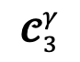
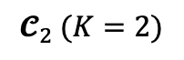
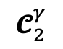
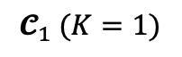
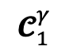
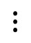
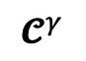
Proof Sketch of Upper Bound (Thm 2)
$${\text{𝓒}}^{γ}$$
Consider any code 𝓒 satisfies $\lim_{n→∞}{𝔻({\hat{Q}}_{Z^{n}}∥W_{Z|X=0}^{n})≤δ}$
There exists a subset ${\text{𝓒}}^{γ}$ such that [Tahmasbi-Bloch’TIT18]
$\left|{\text{𝓒}}^{γ}\right|≥\frac{\left|\text{𝓒}\right|}{n}$
Hamming weight of every codeword in ${\text{𝓒}}^{γ}{≲t}_{δ}\sqrt{n}$
By pigeonhole principle, there exists a ${\text{𝓒}}_{i}^{γ}≜{\text{𝓒}}_{i}∩{\text{𝓒}}^{γ}$ such that
$\left|{\text{𝓒}}_{i}^{γ}\right|≥\frac{\left|{\text{𝓒}}_{i}\right|}{n}=\frac{|ℳ|}{n}$
Hamming weight of every codeword in ${\text{𝓒}}_{i}^{γ}{≲t}_{δ}\sqrt{n}$
$${\text{𝓒}}_{1} (K=1)$$
$${\text{𝓒}}_{1}^{γ}$$
$${\text{𝓒}}_{2} (K=2)$$
$${\text{𝓒}}_{2}^{γ}$$
$${\text{𝓒}}_{3} (K=3)$$
$${\text{𝓒}}_{3}^{γ}$$
$$⋮$$
$${\text{𝓒}}_{|𝒦|} (K=|𝒦|)$$
$${\text{𝓒}}_{|𝒦|}^{γ}$$
[Tahmasbi-Bloch’TIT18] First- and second-order asymptotics in covert communication, IEEE Trans. Inf. Theory, 2018

Slide 15
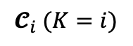
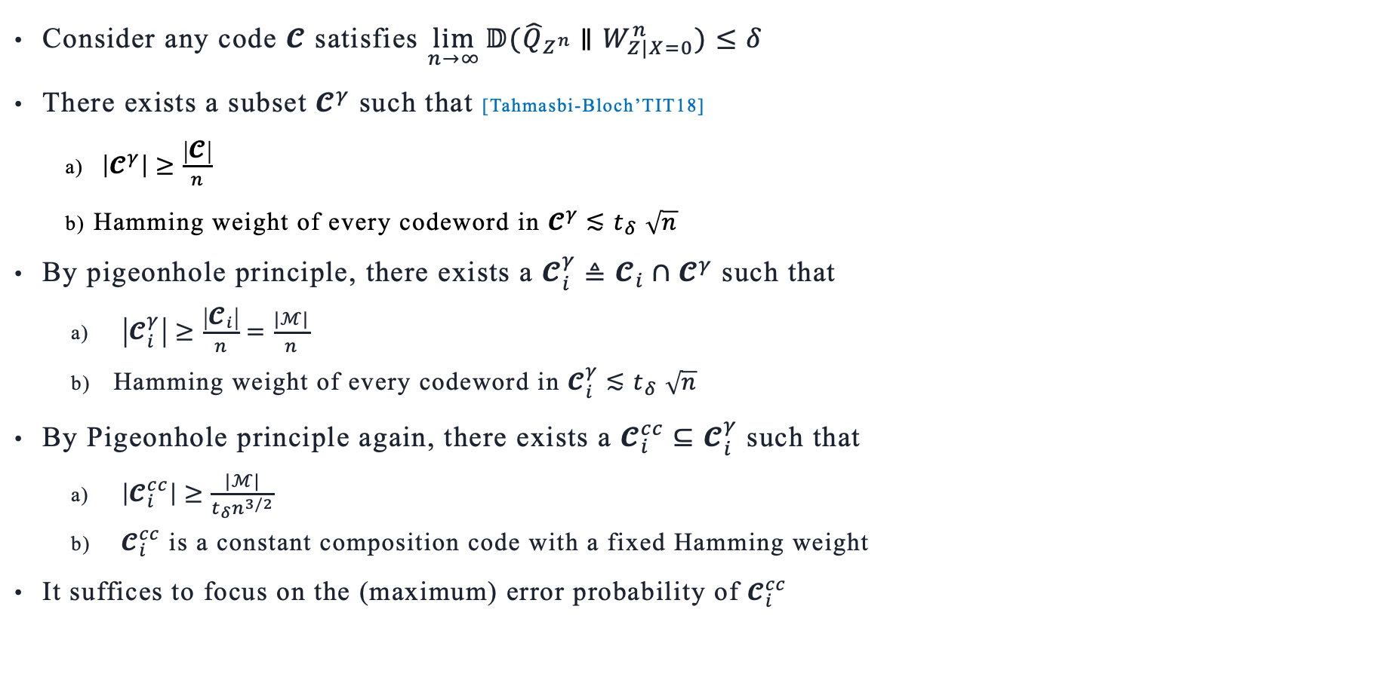
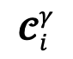
Proof Sketch of Upper Bound (Thm 2)
$${\text{𝓒}}^{γ}$$
Consider any code 𝓒 satisfies $\lim_{n→∞}{𝔻({\hat{Q}}_{Z^{n}}∥W_{Z|X=0}^{n})≤δ}$
There exists a subset ${\text{𝓒}}^{γ}$ such that [Tahmasbi-Bloch’TIT18]
$\left|{\text{𝓒}}^{γ}\right|≥\frac{\left|\text{𝓒}\right|}{n}$
Hamming weight of every codeword in ${\text{𝓒}}^{γ}{≲t}_{δ}\sqrt{n}$
By pigeonhole principle, there exists a ${\text{𝓒}}_{i}^{γ}≜{\text{𝓒}}_{i}∩{\text{𝓒}}^{γ}$ such that
$\left|{\text{𝓒}}_{i}^{γ}\right|≥\frac{\left|{\text{𝓒}}_{i}\right|}{n}=\frac{|ℳ|}{n}$
Hamming weight of every codeword in ${\text{𝓒}}_{i}^{γ}{≲t}_{δ}\sqrt{n}$
By Pigeonhole principle again, there exists a ${\text{𝓒}}_{i}^{cc}⊆{\text{𝓒}}_{i}^{γ}$ such that
$\left|{\text{𝓒}}_{i}^{cc}\right|≥\frac{|ℳ|}{t_{δ}n^{3/2}}$
${\text{𝓒}}_{i}^{cc}$ is a constant composition code with a fixed Hamming weight
It suffices to focus on the (maximum) error probability of ${\text{𝓒}}_{i}^{cc}$
$${\text{𝓒}}_{i} (K=i)$$
$${\text{𝓒}}_{i}^{γ}$$
[Tahmasbi-Bloch’TIT18] First- and second-order asymptotics in covert communication, IEEE Trans. Inf. Theory, 2018

Slide 16



Proof Sketch of Upper Bound (Thm 2)
A clever approach [Kangarshahi-Guillén i Fàbregas’TIT21]
$P_{err}({\text{𝓒}}_{i}^{cc})$ over $(W_{Y|X},q)$ can be related to $P_{err}({\text{𝓒}}_{i}^{cc})$ over an auxiliary channel with ML decoding
Auxiliary channel: marginal distribution $P_{\hat{Y}|X}$ of any $P_{Y\hat{Y}|X}∈𝒫_{max}\left(q\right)$ such that $P_{Y|X}=W_{Y|X}$
Consider the “worst” auxiliary channel among all possible auxiliary channels
${\overline{R}}_{q,δ}$ is the “capacity” of the worst auxiliary channel w.r.t. the constant composition input weight $t_{δ}\sqrt{n}$
The key lemma [Theorem 5, Kangarshahi-Guillén i Fàbregas’TIT21] does not apply to CC codes of weight $O(\sqrt{n})$
A strengthened lemma (Lemma 5) that applies to low-weight CC codes is provided
Definition (borrowed from [Kangarshahi-Guillén i Fàbregas’TIT21]). Let $𝒮_{q}\left(y,\hat{y}\right)≜\left\{x∈𝒳 | x={argmax}_{x^{′}∈𝒳}\frac{q\left(x^{′},\hat{y}\right)}{q\left(x^{′},y \right)}\right\}$.
We define
$$𝒫_{max}\left(q\right)≜\left\{P_{Y\hat{Y}|X}∈𝒫\left(𝒴×𝒴 | 𝒳\right):P_{Y\hat{Y}|X}\left(y,\hat{y} | x\right)=0 for all \left(y,\hat{y}\right)∈𝒴×𝒴 and x∉𝒮_{q}\left(y,\hat{y}\right)\right\}$$
Theorem 2 (Upper Bound): Let ${\overline{R}}_{q,δ}≜t_{δ}∙\left[\min_{P_{Y\hat{Y}|X}∈𝒫_{max}\left(q\right):P_{Y|X}=W_{Y|X}}{ 𝔻\left(P_{\hat{Y}|X=1}∥P_{\hat{Y}|X=0}\right)}\right]$.
The covert mismatch capacity $C_{q,δ}$ $≤{\overline{R}}_{q,δ}$.
[Kangarshahi-Guillén i Fàbregas’TIT21] A single-letter upper bound to the mismatch capacity, IEEE Trans. Inf. Theory, 2021
Notes:
The key lemma is used to related the size of the codebook to the maximum error probability, via the method of types.

Slide 17






An Improved Upper Bound
A clever approach [Kangarshahi-Guillén i Fàbregas’TIT21]
$P_{err}({\text{𝓒}}_{i}^{cc})$ over $(W_{Y|X},q)$ can be related to $P_{err}({\text{𝓒}}_{i}^{cc})$ over an auxiliary channel with ML decoding
More observations [Somekh-Baruch’TIT22]
The output alphabet of auxiliary channel may not necessarily be $𝒴$
The decoding rule w.r.t. the auxiliary channel may not necessarily be ML decoding
${\overline{R′}}_{q,δ}$ at least as good as ${\overline{R}}_{q,δ}$, since ${\overline{R′}}_{q,δ}≤\min_{P_{Y\hat{Y}|X}∈𝒫_{max}\left(q\right):P_{Y|X}=W_{Y|X}}{C_{q,δ}\left(P_{\hat{Y}|X},W_{Z|X}\right)}$
$Γ\left(q,ρ\right)=𝒫_{max}\left(q\right)$
if $𝒰=𝒴$ and $ρ=q$
Definition [Somekh-Baruch’TIT22]. Let $𝒰$ be a given set and $ρ:𝒳×𝒰→(0,∞)$ be a decoding metric. Let the set of broadcast channels be $Γ\left(q,ρ\right)≜\left\{P_{YU|X} | ∀\left(x,y,u\right) such that \frac{ρ\left(x,u \right)}{q\left(x,y \right)}<\max_{x^{′}∈𝒳}\frac{ρ\left(x^{′},u \right)}{q\left(x^{′},y \right)},P_{YU|X}\left(y,u | x\right)=0\right\}$.
An improved upper bound: Let ${\overline{R′}}_{q,δ}≜\min_{{(ρ,P}_{YU|X}):P_{YU|X}∈Γ\left(q,ρ\right):P_{Y|X}=W_{Y|X}}{C_{ρ,δ}\left(P_{U|X},W_{Z|X}\right)}$.
The covert mismatch capacity $C_{q,δ}$ $≤{\overline{R′}}_{q,δ}$.
Covert mismatch capacity
w.r.t. $P_{U|X}$ and $W_{Z|X}$
$$≤C_{δ}\left(P_{\hat{Y}|X},W_{Z|X}\right)=t_{δ}∙𝔻\left(P_{\hat{Y}|X=1}∥P_{\hat{Y}|X=0}\right)$$
[Somekh-Baruch’TIT22] A single-letter upper bound on the mismatch capacity via multicast transmission, IEEE Trans. Inf. Theory, 2022
[Kangarshahi-Guillén i Fàbregas’TIT21] A single-letter upper bound to the mismatch capacity, IEEE Trans. Inf. Theory, 2021
Notes:
The intuition of the improved upper bound is that the error event of the \rho-decoder applies to P_{U|X} is contained in the error event of the q-decoder applies to P_{Y|X}=W_{Y|X}.
The last point, covert mismatch capacity C_{q,\delta} <= covert capacity C_q, and C_q equals “t_{\delta} \times KL divergence”。

Slide 18
Q & A
THANK YOU

